Slide 1
Peas in a Pod Kate Hickey
A Hands on Learning Activity for grades 4-7

Slide 2
Prerequisites:
In order to complete this activity, students need to have prior knowledge and understanding in the following areas:
1. Student is able to measure lengths.
2. Student is able to apply the “look for a pattern” strategy in order to problem solve.
3. Student is able to plot points on a two-dimensional coordinate system.

Slide 3
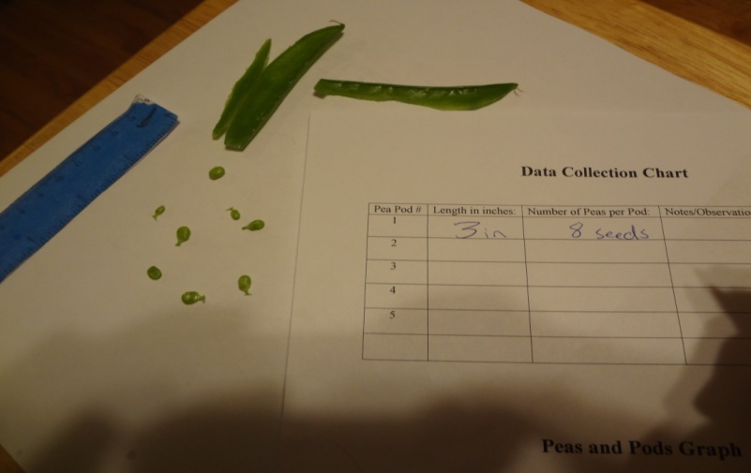
Peas grow inside little bags on the pea plant called “pods.” Some pods have more peas than others. Can you tell how many peas will be in a pod by measuring its length?
What do you think?
Let’s all make a prediction…….

Slide 4
Lesson Goal:
The student will be able to collect and record data and use the gathered information to form a valid conclusion.

Slide 5
Objectives:
1. Given a ruler, pea pods, and a blank chart, the student will collect and record data with 100% accuracy.
2. Given a complete data chart and graph paper, the student will plot and graph data to show the relationship between two variables with 100% accuracy.

Slide 6
Some vocabulary words we will be using today:
Pattern - a predictable sequence of behavior
and
Variable(s) - a symbol representing an unspecified member of a set of objects
The materials we will be using for this activity are:
- Ruler
- Five pea pods
- Data collection chart
- Pea and Pods graph

Slide 7
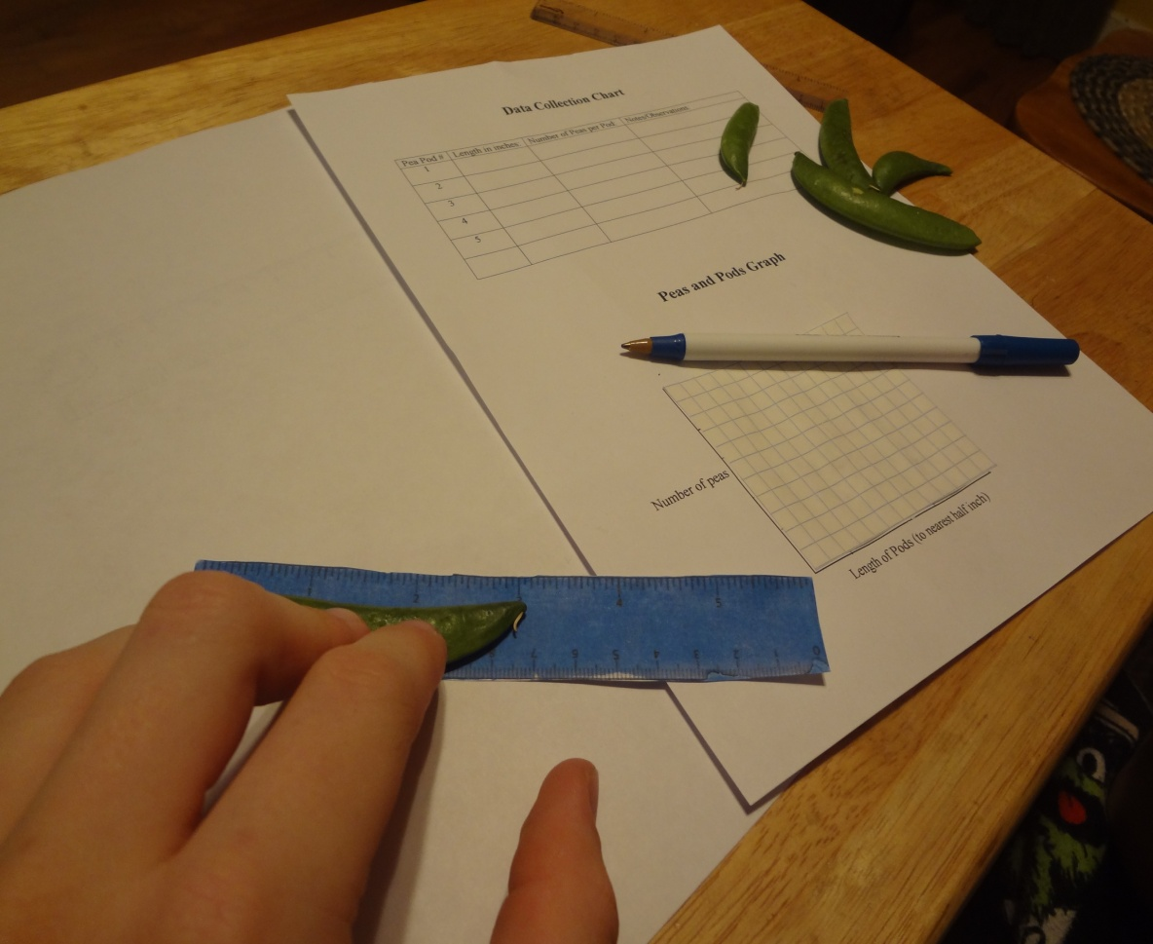
Procedure:
1. Work together with your group members and measure each of the pods to the closest half inch.

Slide 8
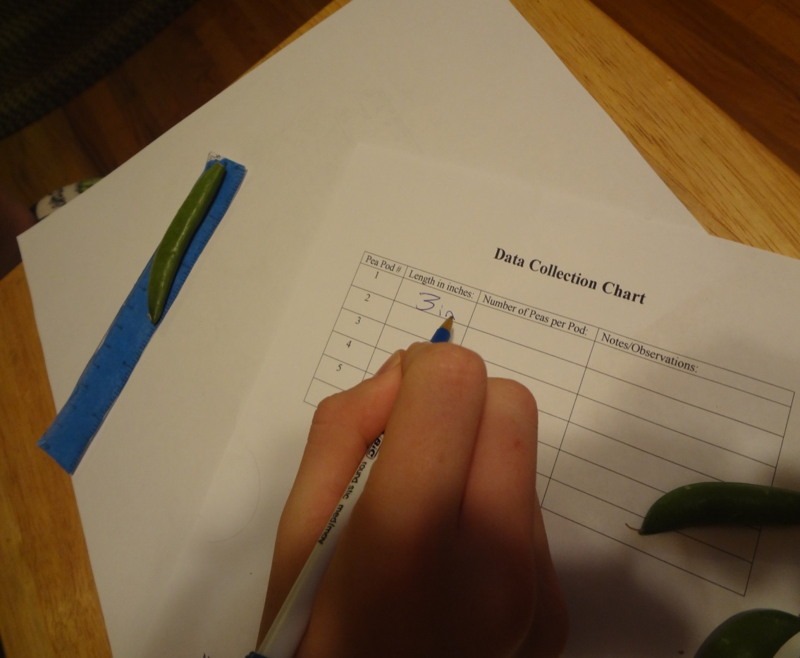
2. Record your measurements on the data collection charts along with any notes or observations you have.

Slide 9
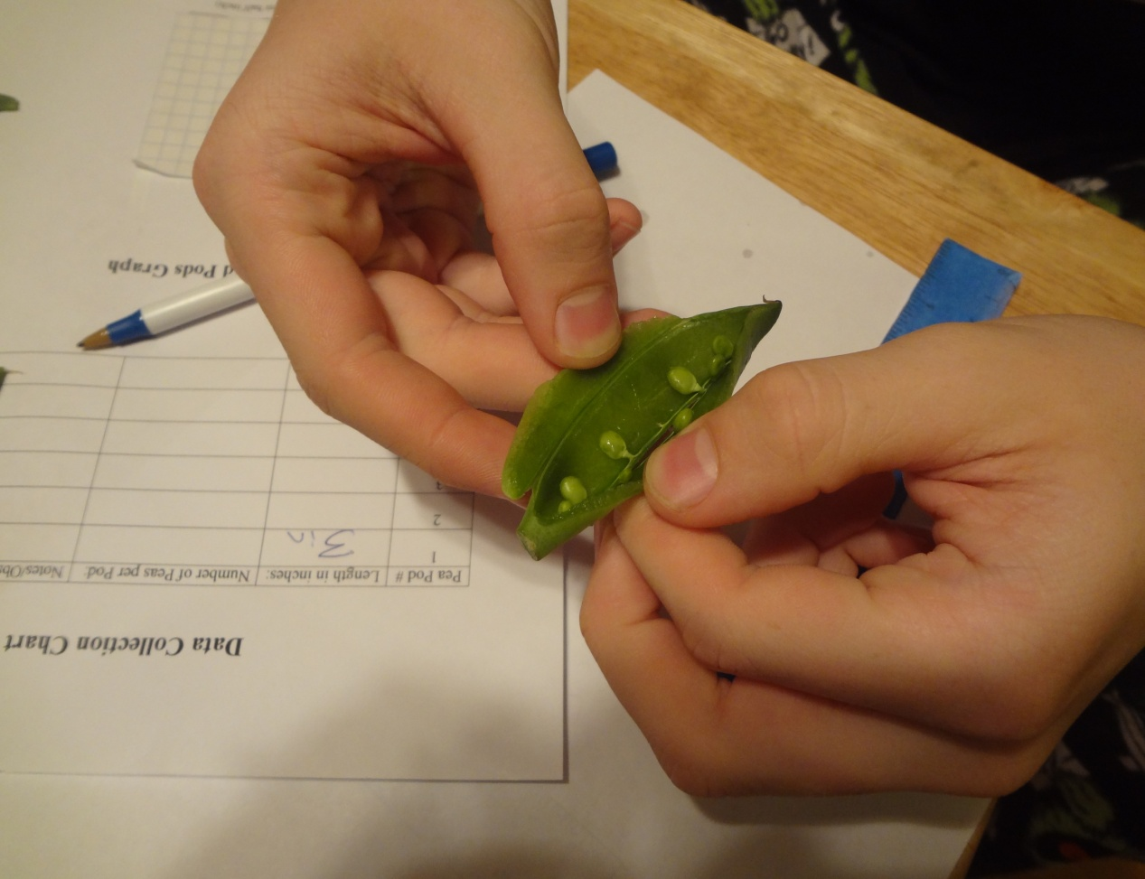
3. Once you have finished measuring all of your pods, open each one of them. Count the number of peas in each pod and record the information on the data collection charts.

Slide 10
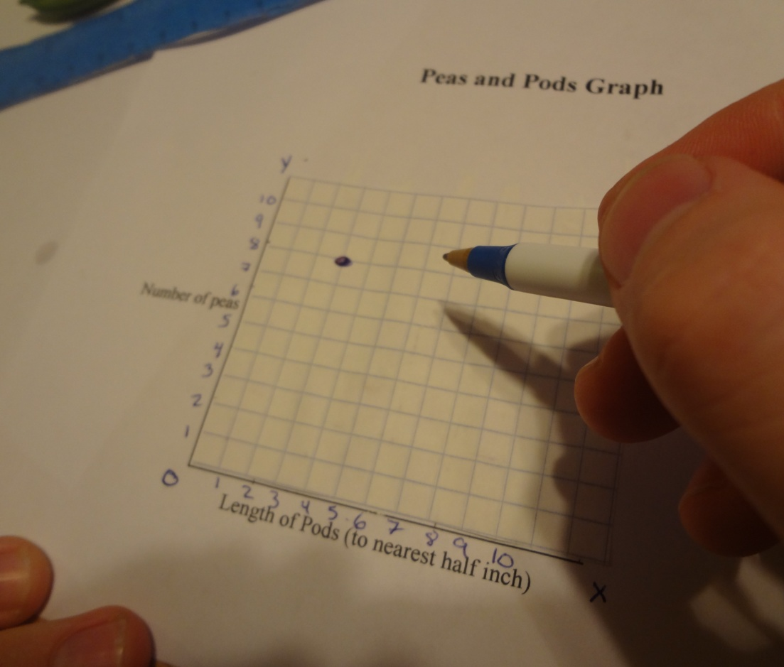
4. Using the Peas and Pods graph, work together to plot your data. (Remember….you will need to alter the numbers on the X and Y axis based on how high your data points are.)

Slide 11
Now, let’s take a look at our graphs…... Do you see a pattern between the number of peas in a pod and the pods length?
Let’s look at some sample data:
Pea Pod # Length in inches: Number of Peas per Pod:
1 3 inches 8 peas
2 2 inches 5 peas
3 5 inches ? peas
We can see that when we had a three inch pod it contained eight peas. A two inch pod contained five peas.
Using variables, we can assign the letter X to represent the length of the pod and let the letter Y represent the number of peas.
According to our chart we know that setting X=Y and plugging in our data gives us the following:
3=8 and 2=5
We need to come up with an equation that we can use to help us predict the number of peas in a pod based on the pods length.

Slide 12
We need to come up with an equation that we can use to help us predict the number of peas in a pod based on the pods length.
# (X) = Y
To get three to equal eight we can multiply it by three, which gives us nine. We can then subtract one, which gives us our eight.
3 (3) – 1 = 8
So, we have the equation:
3 (length of pod) – 1 = number of peas
3 ( X ) – 1 = Y
Let’s see if it works for our second pod data:
3 (2) -1 = Y
6 – 1 = 5
Our data shows that for a two inch pod it contains five peas so we have created an equation that shows the relationship between the two variables.

Slide 13
References:
Peas in a Pod math activity idea taken from:
http://www.thefutureschannel.com/hands-on_math/peas_in_a_pod.php

